Slide 1

Hypothesis Testing
Conceptual Understandings

Slide 2

Politics in Academia: Publish or Perish

Slide 3
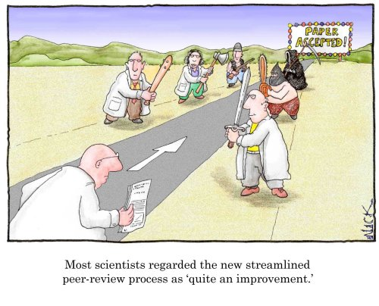
Politics in Academia: Publish or Perish
Note quite: Must have significant results

Slide 4
Hypothesis Testing
an inferential statistical technique used to determine whether or not data, collected from samples in the course of an experiment or study, support or refute the researcher’s hypothesis.
two competing hypotheses are tested by this process
Ho: the null or working hypothesis
says there is NO difference or NO relationship between the two or more groups or variables in the population. Any difference or relationship found in the samples is the result of sampling error alone.
We ALWAYS assume Ho is true until we have enough evidence to the contrary. In other words, we adopt the “Innocent until proven guilty” philosophy.

Slide 5

Ha: the alternate or researcher’s hypothesis
says that there IS a difference or a relationship between the two or more groups or variables in the population. Any difference or relationship found in the samples reflects something in addition to sampling error.
Ho and Ha are mutually exclusive
Surprise, surprise!
The data we collect will either support or refute Ho. If the data supports Ho, it does not PROVE Ho. The best we can do is show that it is probably true.
What would it take to prove Ho is true?

Slide 6

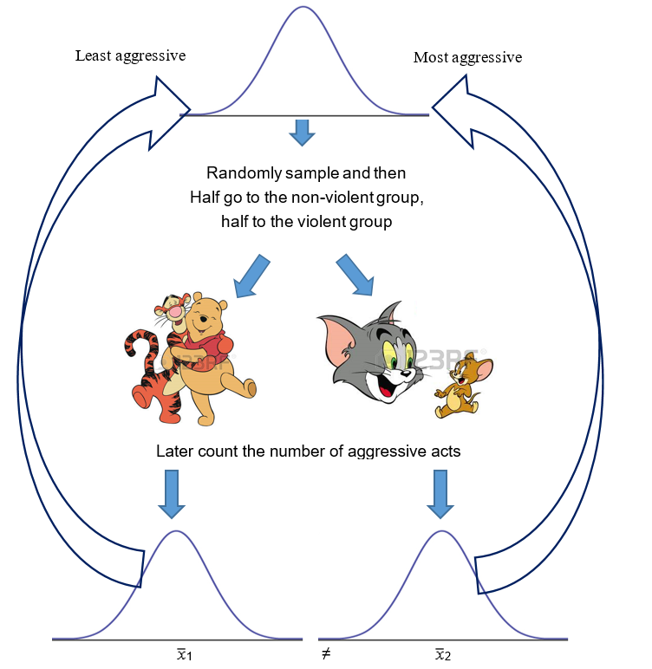
Example: will watching violent cartoons increase
aggression in 4-6 year old boys?
According to Ho
Ho: μ₁ = μ₂
Ho states the sample means are different because of sampling error alone.
Aggression in boys is the same after watching either cartoon - probably

Slide 7
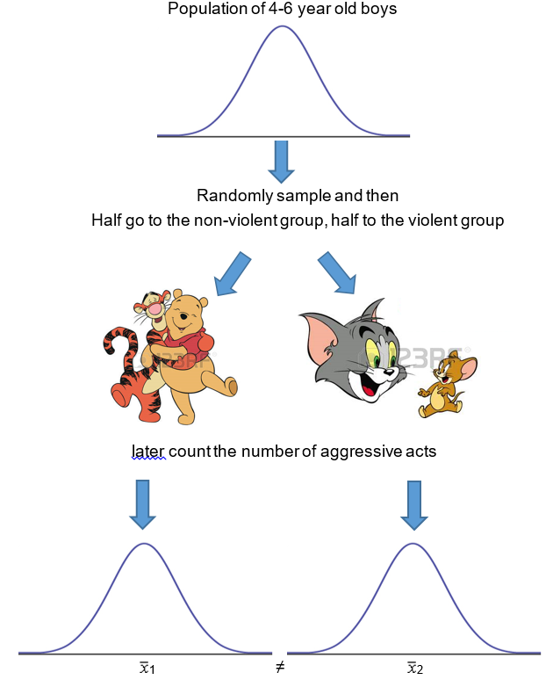
According to Ha
Ha: μ₁ ≠ μ₂
Ha states the sample means are different because of sampling error plus something else!
Aggression in boys is higher after watching the violent cartoon - probably

Slide 8

What is so good about hypothesis testing?
Provides a procedure and objective criteria for making decisions
what am I seeing in my samples?
is this sampling error?
is there something more going on?
The decision is removed from the hands of
the researcher and placed at the mercy of
the data.
If the data support Ho, you have a non-significant result.
You are probably looking at sampling error.
If the data do not support Ho, you have a significant result!
You probably are looking at something in addition to sampling error!

Slide 9
Hypothesis Testing
Conceptual Understandings

Slide 10
The fallibility of hypothesis testing
 | Ho is TRUE in reality | Ho is FALSE in reality
statistics say retain Ho | correct decision | Type II error
statistics say reject Ho | Type I error | correct decision
We use hypothesis testing on sample data. Any decision we
make could be right or wrong.
Type I error: claiming you have a significant effect when you do not.
analogous to a “false positive”
Type II error: claiming you have a non-significant effect when you
do have something - analogous to a “false negative”

Slide 11

Type I vs. Type II errors – which is worse?
Consider Impact to the Field: type I errors get published more
than type II errors – in this sense,
type I errors are worse
Consider the consequences for a specific study:
for example, is it worse to think
you have a cure for COVID and
you don’t (a type I error)
is it worse to think you do not
have a cure for COVID, when
you actually do (a type II error)
or

Slide 12

Steps and logic of hypothesis testing: In brief
1) State Ho and Ha in words or in symbols
2) Choose a value for α (alpha, also known as the level of significance)
Decide on which hypothesis test you are going to run.
Regardless of which test you do, you will end up calculating a
number called a test statistic (TS).
Compare the value of the TS to the value of TS critical (the TS critical is like a cutoff score)
If TS > TS critical, reject Ho. If TS < TS critical, retain Ho

Slide 13

Steps and logic of hypothesis testing: The details
Stating Ho and Ha: Seasoned veterans generally know what Ho and Ha say and rarely write them down.
But you should ☺
2. Choose the Level of Significance (alpha)
Alpha (α) is the probability of making a
type I error i.e. rejecting Ho when Ho is true.
We generally do not want alpha to exceed .05 (5%) or .01 (1%)

Slide 14

How does alpha affect our decision to reject or retain Ho?
We will decide to reject Ho only when there is less than a 5% or 1% chance that we are making a type I error
If the probability of a type I error is greater than .05 or .01,
we would RETAIN Ho… the risk of an error associated with
rejecting Ho is too high
Statisticians prefer you say “fail to reject Ho” instead of retain Ho

Slide 15

How do we know what the risk of a type I error equals?
The short answer….
The probability of a type I error is less than 5% (or 1%) when
the probability of our test statistic (TS) is less than 5% (or 1%)
when Ho is true.
3. Calculate the T.S.
Before you can figure out the probability
of the TS under Ho, you need to calculate
the TS
Duh!

Slide 16
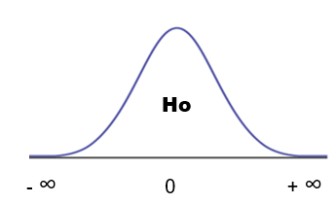
How can we figure out the probability of our test statistic (TS)?
plot the TS on a standardized frequency distribution
representing Ho and find the area under the curve.
The Ho distribution
Null, nadda, nothing!
- t.s.
+ t.s.
This hypothetical distribution tells us that a TS of ANY size “could”
belong to Ho, but some are more probable than others. Which ones are
Improbable?

Slide 17
Null, nadda, nothing!
- t.s.
+ t.s.
TS values around 0 are probable, TS values in either tail are improbable. If a TS is a very unlikely event on Ho, maybe we should reject Ho?
How do we know what the probability of OUR TS equals?
If using SPSS, just look at the Sig value! This is the exact prob. A type 1 error

Slide 18
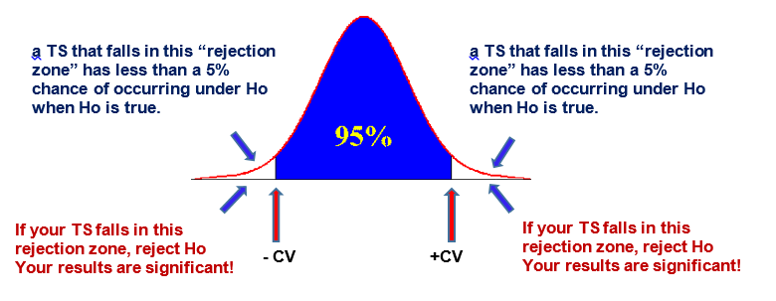
At this point, we just want to know if our TS occurs less than
5% or 1% of the time under Ho. How can we tell?
For alpha .05, find the values of the TS that define the outer 5% of
the curve. These values are called the CRITICAL VALUES (CV)
2.5%
2.5%
Use a Z or t table to find the value of the CV

Slide 19
4. Significant vs non-significant: compare your TS to the CV
If a TS falls here, it is a high probability event on Ho
There is no basis to reject Ho: the TS is NOT significant
If a TS is not significant (p >.05), retain Ho, your results probably reflect sampling error
If a TS is significant (p <.05), reject Ho, your results probably reflect something in addition to sampling error

Slide 20
Rejection Zones represent the probability of a type 1 error
Ho
When the TS is in a rejection zone, we reject Ho
but the TS could still belong to Ho, right?
If the TS really does belong to Ho and we rejected HO
We’ve just made a Type 1 error!

Slide 21
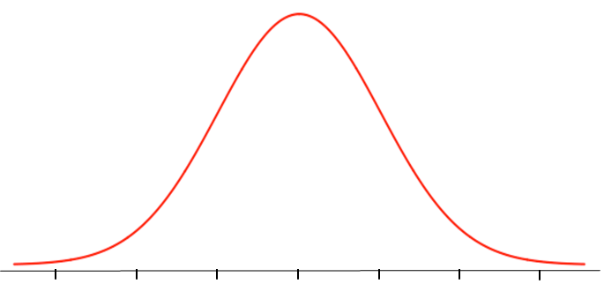
Rejection zones if using alpha .01
Ho
99%
1/2%
1/2%
- C.V. 0 C.V.
If a TS is greater than
the - CV
Reject Ho,
the TS is significant
p <.01
If a TS is greater than
the + CV
Reject Ho,
the TS is significant
p <.01
If a TS is less than +/- CV
Retain Ho, the TS is not
significant, p >.01

Slide 22

The Significance Myth!
“A TS that is significant at p < .01 is MORE significant than a TS that
is significant at p < .05”, right?
WRONG!
That’s like saying a woman who is 5 months pregnant is more
pregnant than a woman who is 3 months pregnant.
But pregnant is pregnant, and significant is significant!
So what IS the difference between p < .01 and p < .05?
Risk of a type I error!

Slide 23
Rejection Zones represent the probability of a type 1 error
Ho
When the TS is in a rejection zone, we reject Ho
but the TS could still belong to Ho, right?
If the TS really does belong to Ho and we rejected HO
We’ve just made a Type 1 error!
Remember why Ho is called the working hypothesis?

Slide 24

What about Ha?
Extends from
positive to negative
infinity
Hypothetical
Values plotted on the X-axis are TS values
Represents the probability of getting any TS when there is
something more than sampling error

Slide 25
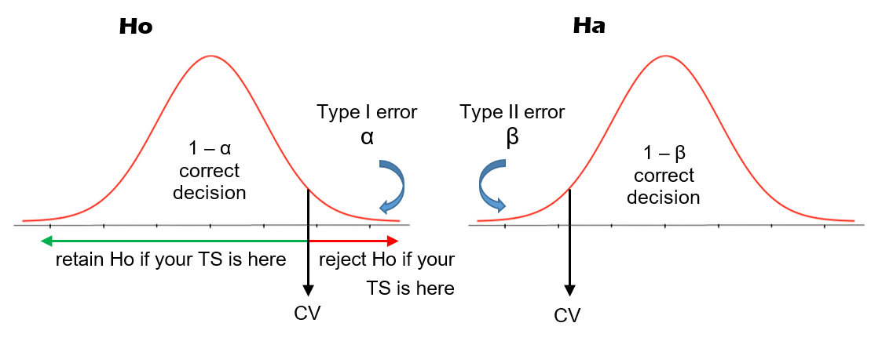
Mapping hypothesis testing outcomes onto Ho & Ha
Ho & Ha must therefore overlap. Let’s look at them separately first.
The two areas under Ho are 1 – α and α. They are the prob. of correctly retaining Ho
and incorrectly rejecting Ho. These two areas must sum to 1.

Slide 26
Mapping hypothesis testing outcomes onto Ho & Ha
The two areas under Ha are 1 – β and β. They are the prob. of correctly rejecting Ho
and incorrectly retaining Ho. These two areas must sum to 1.

Slide 27
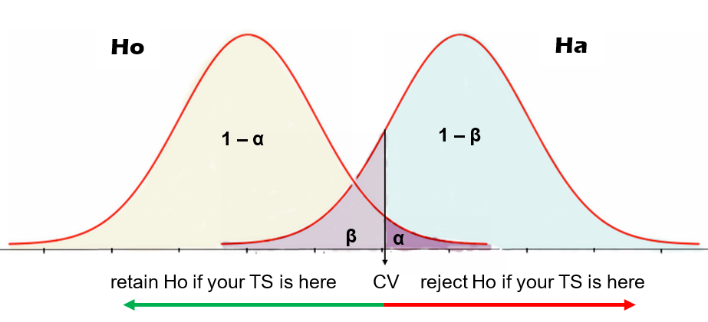
If we retain Ho, the two areas we might be in are either 1 - α (i.e. prob. of correctly
retaining Ho) or β (prob. of a type II error and missing a real treatment effect)
If we reject Ho, the two areas we might be in are either α (i.e. prob. of a type I error)
or 1 – β (prob. of correctly rejecting Ho and detecting a real treatment effect)

Slide 28

What a significant result does and does not tell us!
If we get a significant result and reject Ho, this means our stats have
supported our specific hypothesis, right?
WRONG!
The statistics support that fact that there is something more than sampling error going on. They do NOT tell us what that something is.
It’s your job to convince others that your IV was responsible.

Slide 29

Power in Hypothesis Testing
Can you order the 4 possible outcomes from most preferred to least?
1 - β
1 - α
β
α
POWER! Correctly rejecting Ho and detecting
a treatment effect is every researcher’s
dream.
1 - β
Note that 1 – β is the probability
of correctly rejecting Ho
How can we maximize this probability
and minimize the risk of a type I and type II error?

Slide 30
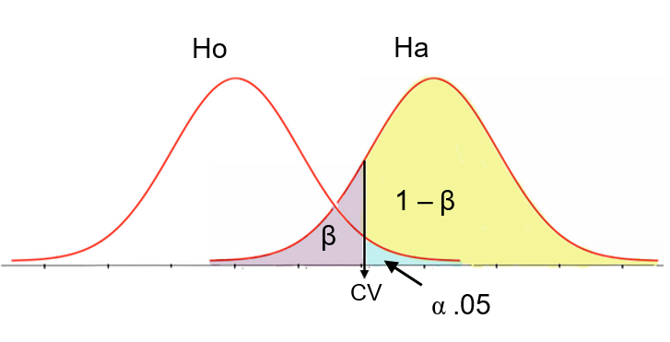
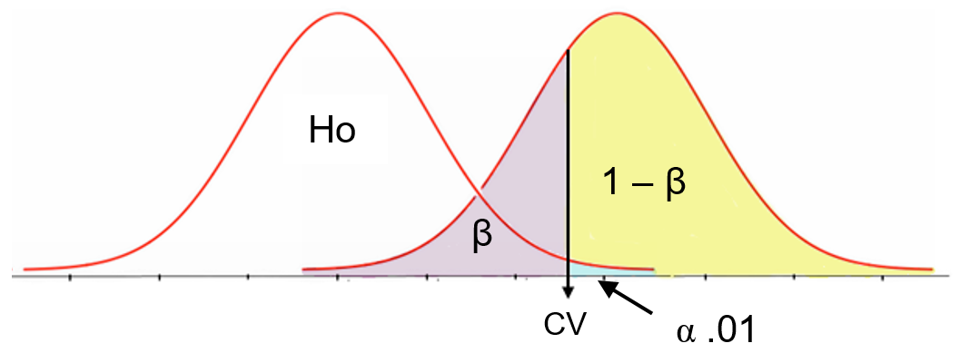
Minimizing errors and maximizing power
Use a smaller (or larger) critical value
Look what happens below – anyone see a problem with this?
Moving the critical value around is not an effective solution – what is?

Slide 31

Increase effect size!
Effect size is a measure of either
how much influence the independent variable has over the dependent variable or
how strong the relationship is between two or more variables.
The larger the effect size, the smaller the risk of making type I and type II errors, and the more power you have.

Slide 32


Absolute vs Relative Effect Size
Absolute effect size in an experiment
    Simply the size of the difference between the means
    Does not allow effect sizes to be compared across experiments
Relative effect size in an experiment
allows effect sizes to be compared
across experiments by
“standardizing” effect size

Slide 33
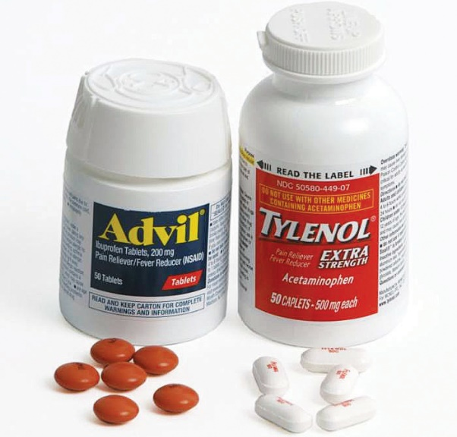
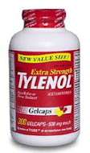
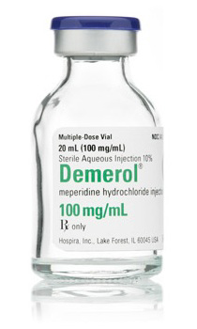
An Example: Tylenol vs. Advil Tylenol vs. Demerol
Expected absolute effect size is
small because you are not likely to
see a big difference between them
Expected absolute effect size is
large because you are very likely to
see a big difference between them
What about relative effect size?

Slide 34
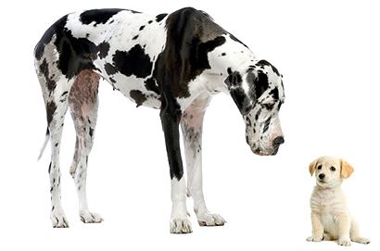

Factors that Influence Effect Size Within a Study
Although many variables likely influence effect size, two stand out.
The magnitude of the difference between the group means or
the strength of the relationship among variables
2. How variable the scores are in the experiment or study

Slide 35
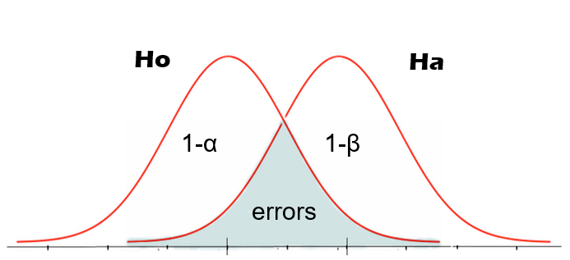
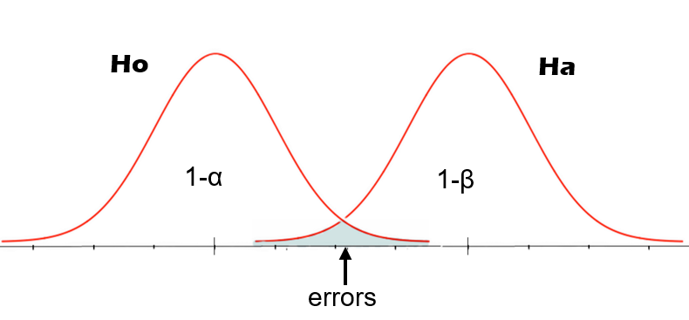
The magnitude of the difference between the group means
Small difference between
sample means bring Ho
and Ha close together.
Overlap will be great
increasing type I and II
errors, decreasing power
and effect size
small absolute effect size
large absolute effect size
The opposite is true
when there are large
differences between
the sample means

Slide 36

How to Increase the Difference between Means
Use strong manipulations.
Manipulate your IV in such a way as
to increase the probability that group
difference will be found.

Slide 37

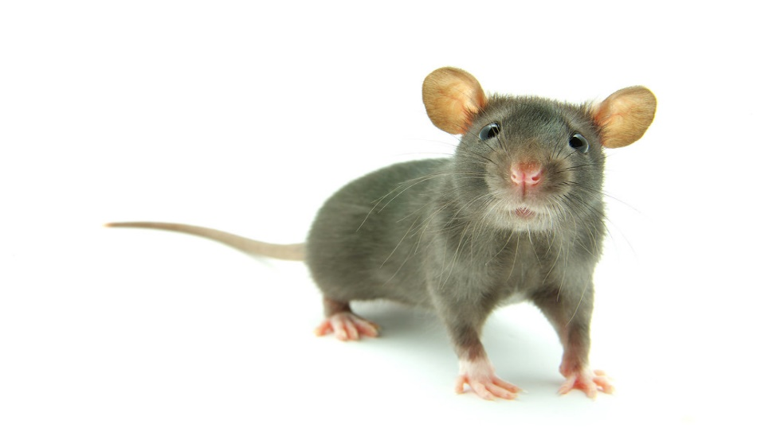
How to decrease score variability, error, and noise in the study
1. Conduct a “clean” experiment. If you are not careful, your behavior
will act as a source of error, cause scores to vary for reasons other
than the IV, and increase noise. This will reduce effect size and
power.
2. Use Homogeneous samples. Restrict the number of ways in which
participants differ from each.
However – this will reduce the generalizability of your results

Slide 38
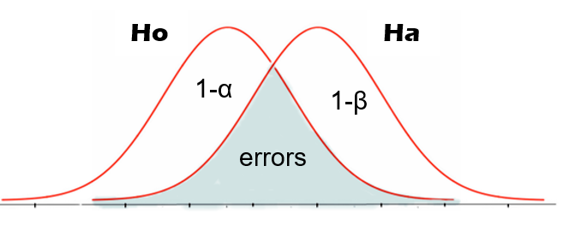
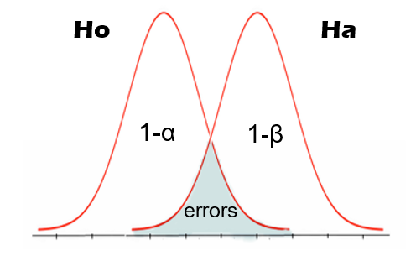
Another way to minimize error and increase power
Increase your sample size.
Bigger samples yield better estimates and decrease sampling error
When SEM is large, Ho and
Ha are more variable (fatter).
As overlap increases, so does
the risk of a type I and type 2
error. This decreases power.
The opposite is true when SEM is small. Overlap decreases, risk of errors decrease, and power increases

Slide 39


Diminishing Returns & Power Analysis
The phenomenon whereby as n continues to increase,
SEM drops but in smaller and smaller increments
Problem with Diminishing Returns
SEM
Sample size
Power Analysis
A way to determine optimal sample size
Need to 1. select a value for power (.8 or .9), 2. estimate standard deviation, 3. decide on minimally acceptable absolute effect size. App will calculate n.

Slide 40
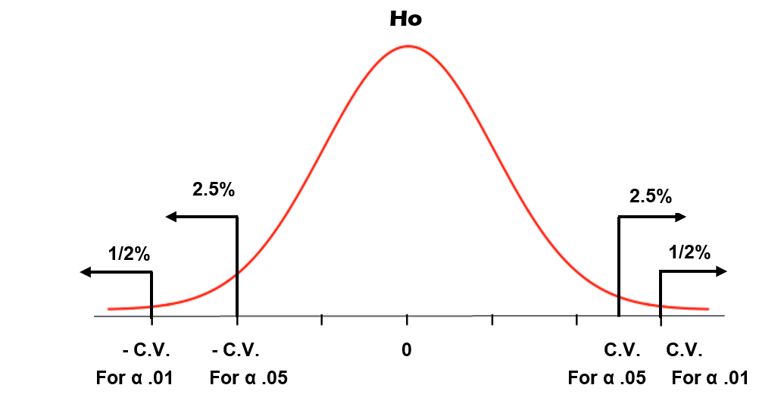
A Tale of Two Alphas: .05 vs .01
Look at the graph below. Which alpha will make it easier to reject
Ho and why?
Hint: look at the critical values!

Slide 41
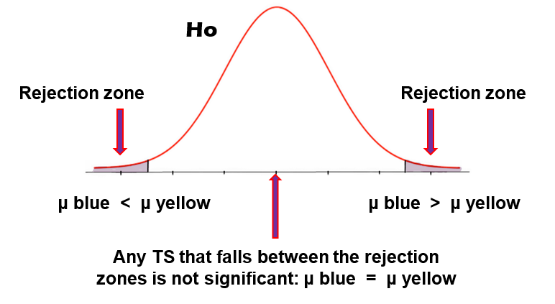
Non-directional and Directional Tests
Non-directional (two-tailed) tests have two rejection zones to allow you to reject Ho regardless of whether µ1 < µ2 or µ1 > µ2

Slide 42
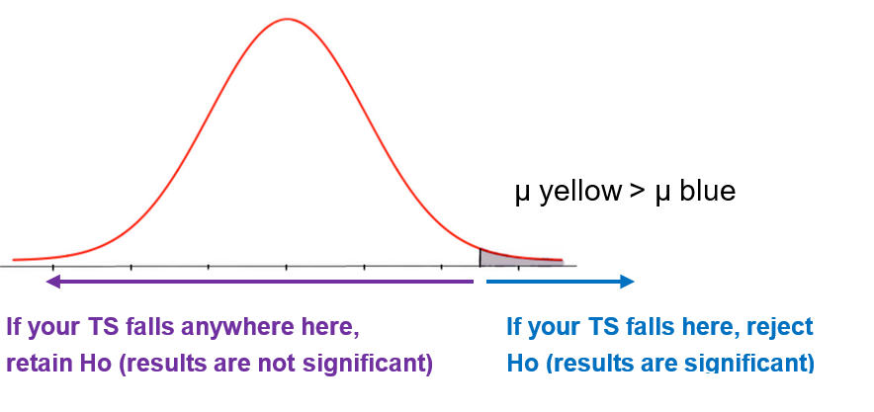
Non-directional and Directional Tests
Directional (one-tailed) tests have one rejection zone. These tests are used when your hypothesis is directional and there is literature to support your prediction.
Here, your TS will be positive.
Oh no, we’re screwed? Not necessarily. Just “flip” your hypothesis and predict the other direction. You can do this as long as you can support your prediction with the literature.

Slide 43
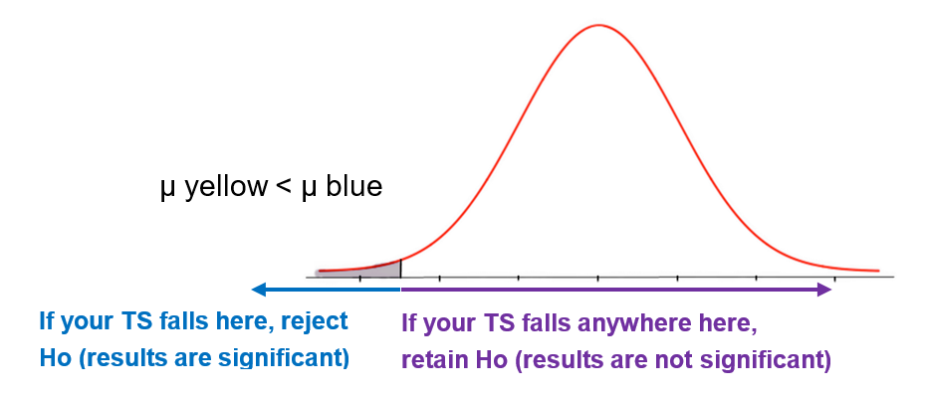

Non-directional and Directional Tests
Predicting the other tail. Here, your TS will be negative.
Remember, if this happens, just “flip it”
if you can and if you want to

Slide 44
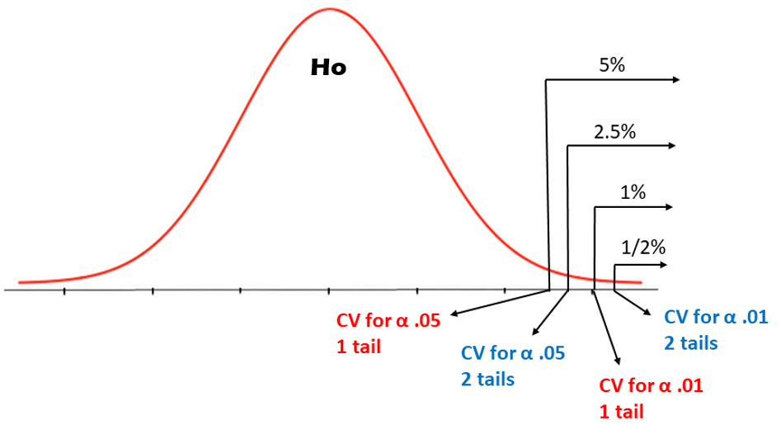
Non-directional and Directional Tests Compared
A one-tailed test makes it easier to reject Ho
This is true for both alpha .05 and alpha .01
But some people “snub their noses up” at one-tailed tests

Slide 45
Non-directional and Directional: Tests vs Hypotheses
Non-directional (two-tailed)
Example of a non-directional hypothesis
Ho: μ₁ = μ₂
Ha: μ₁ ≠ μ₂
If your hypothesis is non-directional,
you must use a non-directional test
Directional (one-tailed)
Example of a directional hypothesis
If your hypothesis is directional,
you have the OPTION of running a
one or two tailed test
Ho: μ₁ ≤ μ₂
Ha: μ₁ > μ₂
Ho: μ₁ ≥ μ₂
Ha: μ₁ < μ₂

Slide 46
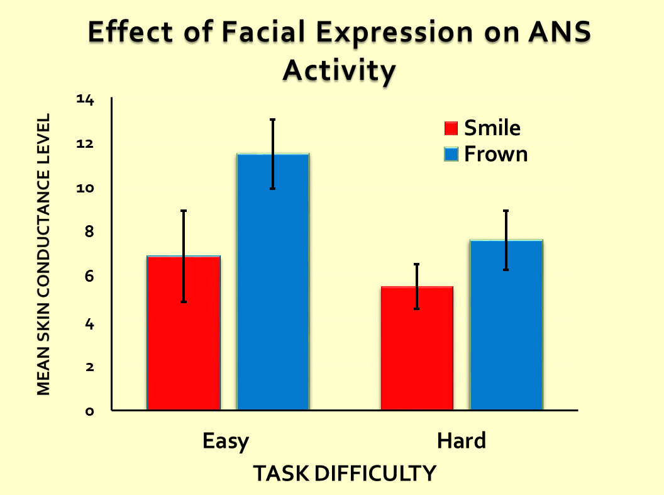
Y-error Bars on Graphs
These look like a capital “i” on a bar or line graph. They represent the
68% CI or the 95% CI around the mean.
If using the 68% CI,
the Y-error bar will be
M +/- Z * SEM
Can you figure out why?
And why do we put error
bars on graphs to begin
with?

Slide 47
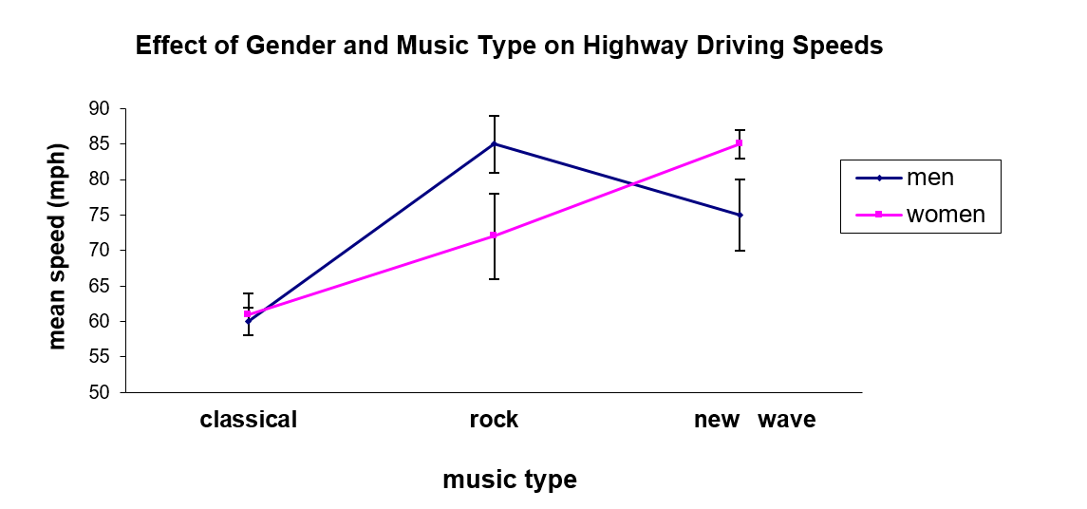
Y-error Bars and Judgements about Significance
If using the 95% CI we can use the following rules:
If the CIs for two means do not overlap, the means will be signif. different
Based on this rule, which means would be significantly different?

Slide 48

Y-error bars and judgements about significance
If two error bars do NOT overlap, the most likely reason why the two means
differ is due to sampling error + something else. The difference between the
means will likely be significant.
If two error bars overlap, the two means might still be significantly different.
This would be the case if:
at least one mean is NOT included in the other group’s error bar
or
each mean is NOT included in the other group’s error bar
Another way of phrasing the rule:
one group’s error bar does NOT include the other group’s mean
or
the error bar for each group does NOT include the other group’s mean
(the rule only works well for IVs that are between subjects)

Slide 49
The two CIs do not overlap
The means are probably
significantly different from
each other
Group 1 Group 2
Mean 1 is not in the CI for mean 2
Mean 2 is not in the CI for mean 1
The means are probably significantly different from each other
Group 1 Group 2

Slide 50
Mean 1 is in the CI for mean 2
HOWEVER
mean 2 is NOT in the CI for mean 1
means could still be significantly
different from each other
Group 1 Group 2
Mean 1 is in the CI for mean 2
Mean 2 is in the CI for mean 1
means are probably NOT significantly different from each other
Group 1 Group 2

