Slide 1

Add your names, semester, and year to the title slide
Covid 19 Vaccines
Myths & Mandates

Slide 2

Our Study’s Purpose
Explore factors that determine
people’s beliefs in vaccine myths
investigate who does or does not support
COVID-19 restrictions

Slide 3
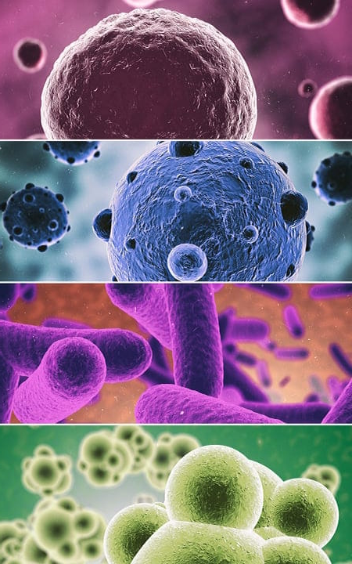
Variables Measured and Manipulated
Gender
Age
University year
Religion
Country of origin
Political Affiliation
Vaccination status
Vaccine intent
Covid infection
Severity of illness
Knowing others

Slide 4

Scales Included in the Survey
Restriction Support Scale
Social gatherings
Masks
COVID Myth Scale
Just a flu
Made up statistics
Vaccine Myth Scale
Microchips
Not tested for safety
Social Concern Scale
Serious Social Problems
in the United States
Used Likert Scale 1 – 6 strongly disagree – strongly agree

Slide 5

PROCEDURE
WHO
PSY 1010 students
Research Pool
WHAT
Anonymous
Survey
HOW
Online using Qualtrics

