Slide 1
Screen time toxicity

Slide 2
Worldwide, 6 billion people have access to a mobile phone, while only 4.5 billion have access to working toilets
The average age when children receive their first smartphone 10 years-old
25% of kids under the age of 6 have phones and half of them spend up to 21 hours a week on them.

Slide 3
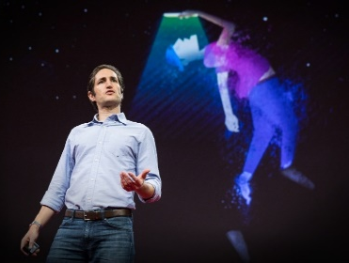
The vast majority of our personal
time is consumed by screen time
Our personal time is what defines us and it is where we develop as individuals.

Slide 4
Not all screen time is bad – but some apps make us unhappy
27
minutes per day
Screen tech’s do not allow their own children to use their own tech

Slide 5
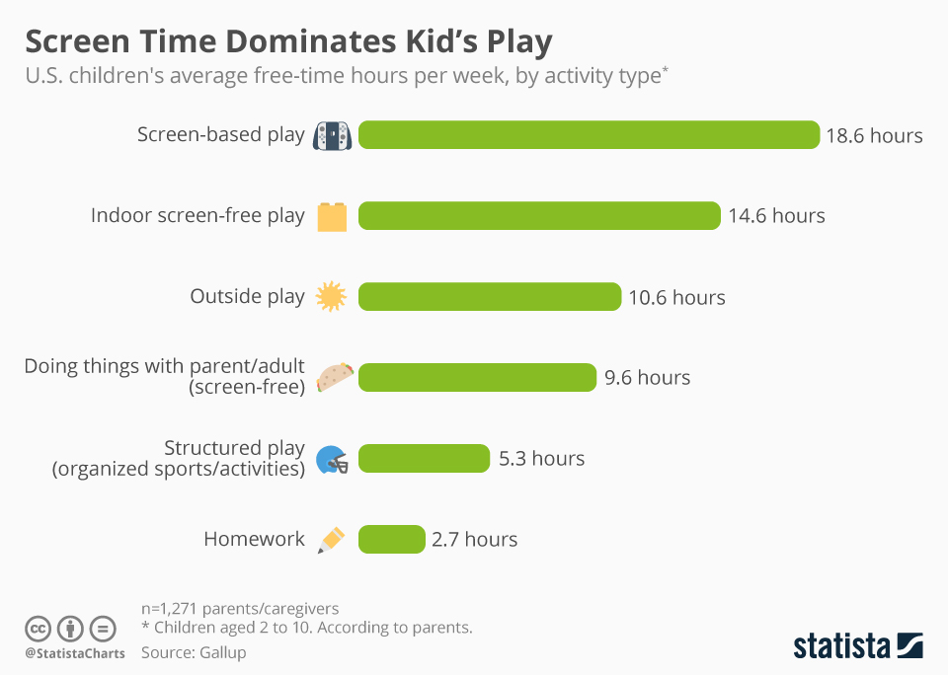
2017

Slide 6
Correlates of Increased Screen Time
Eyesight sleep obesity
Decreased academic and work performance
Changes in brain development
Changes in gene expression
Depression and loneliness

Slide 7
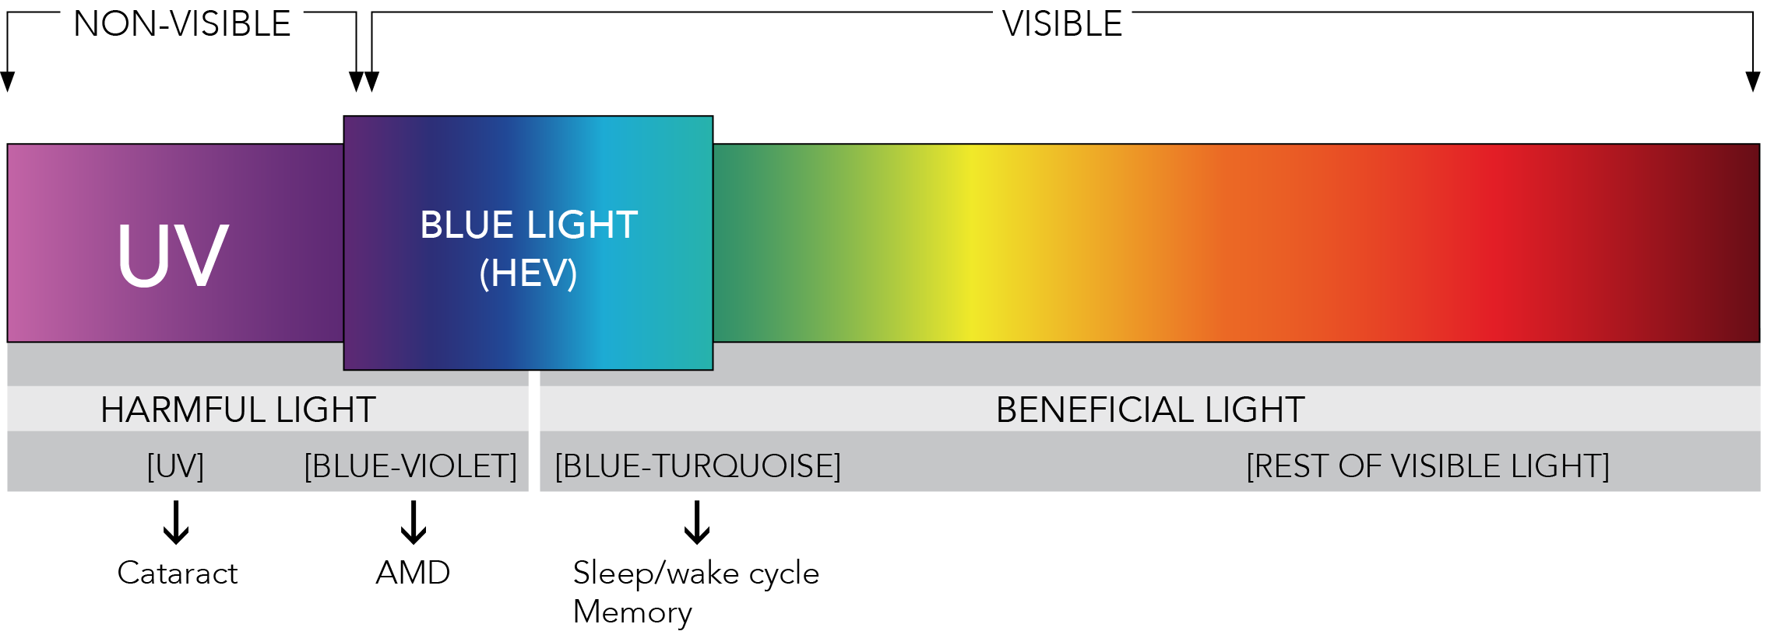
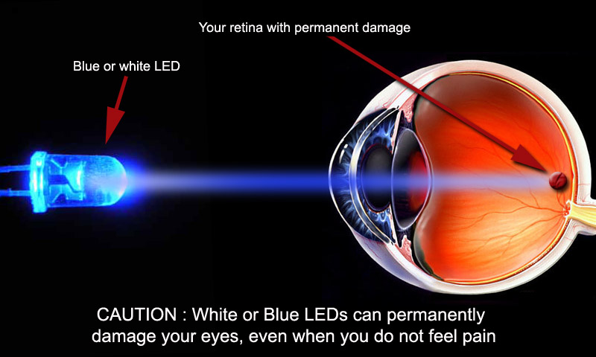
What is blue light?
Visible light with the highest intensity
Blue light could be contributing to macular degeneration (loss of central vision)

Slide 8
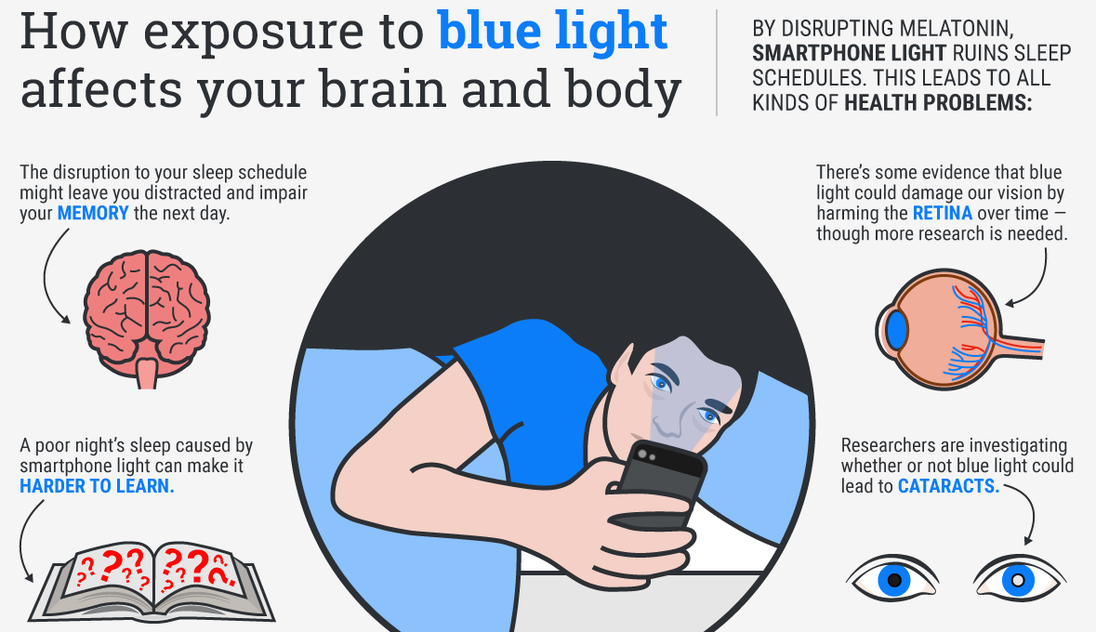

Slide 9
Why or how does screen time affect sleep?
It inhibits the release of melatonin, the sleep hormone.
Some studies suggest a link between exposure to light at night, such as working the night shift, to some types of cancer, diabetes, heart disease, and obesity.
Blue light at night disrupts of the circadian nocturnal melatonin signal and promotes the growth and metabolism of human breast cancer

Slide 10
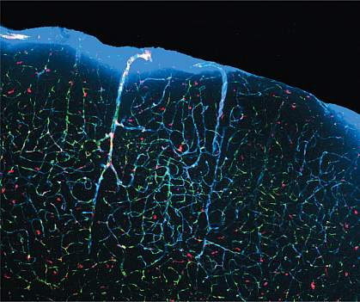
Less sleep means we cleanse our body less of neurotoxins
Cerebrospinal fluid (blue) flows through the brain and clears out toxins through a series of channels that expand during sleep.
This glymphatic system can help remove a toxic protein called beta-amyloid from brain tissue
Build-up of beta-amyloid, a toxic protein, is linked to Alzheimer’s disease

Slide 11
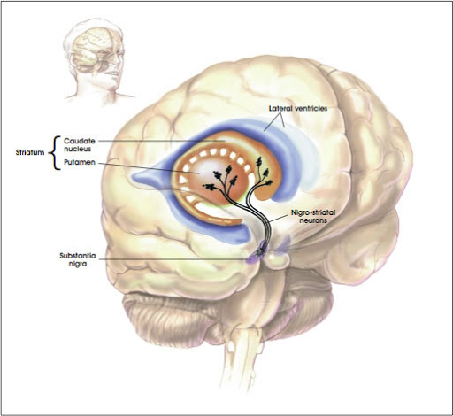
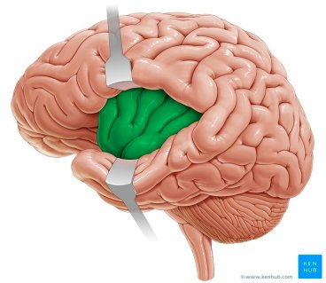
Blue light may reduce the gray matter in our brain
frontal lobes > mediates higher order cognitive function
insula > mediates compassion and empathy
striatum > suppresses socially unacceptable impulses

Slide 12
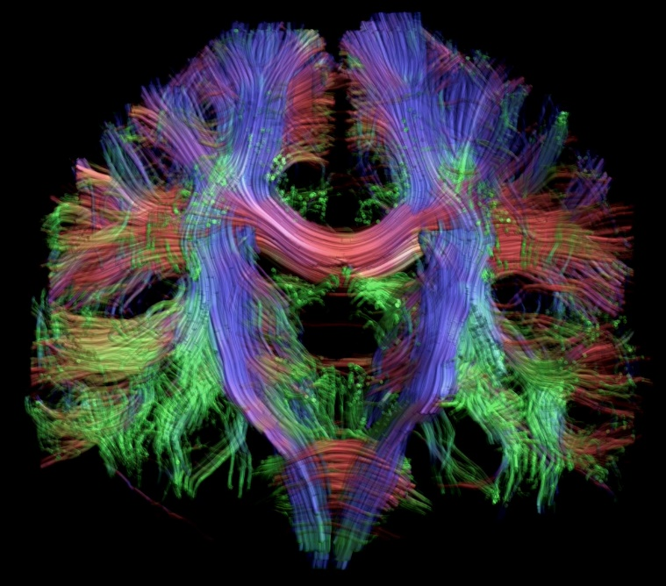
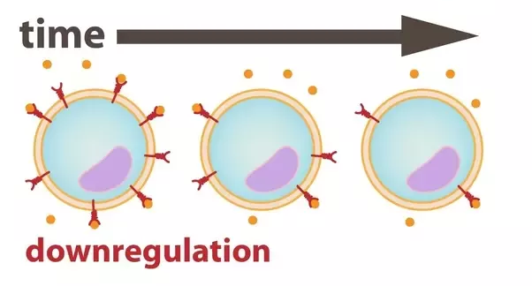
Blue light may reduce the white matter in our brain
disrupts communication within the brain and impairs emotional and cognitive function
Tensor imaging of white matter tracks
Downregulation of DA receptors
similar to what is observed in substance abuse disorders BUT!

Slide 13
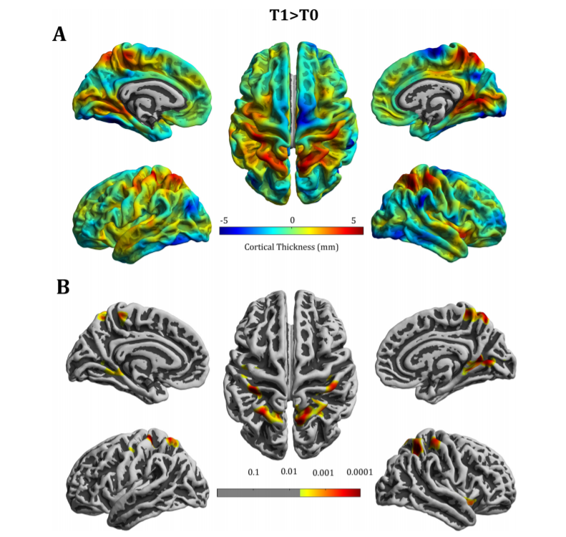
Decreased cortical thickness in video-game
addicts - late adolescent males and females
correlated with impairment of a cognitive task
(A) maps display increase (red) or decrease (blue) in cortical thickness (mm) (B) shows only the significant cluster (p < .001).
Changes in the illustration were observed after just 15 two hour sessions (30 hours total over 4 weeks) of playing a first person shooter videogame.

Slide 15
Excessive screen time > hyperactivity, emotional and conduct problems, difficulty with peers, increased obesity, poorer school performance
Young mice subjected to switching sounds and lights later showed learning deficits

Slide 16
Screen time may influence our epigenome
miRNAs are short single-stranded RNA molecules which control gene networks
miR-222 and miR-146a are associated with inflammation and cardiac pathology
Children’s screen time altered the expression of saliva extracellular miR-222 and miR-146a
As screen time increased, miR-222 and miR-146a increased, independent of BMI and physical activity of the child

Slide 17
Sitting for 8 or more hours per day increases the risk of:
CVD obesity deep vein thrombosis
diabetes pain metabolic syndrome
Sitting and lying down results in a sluggish lymphatic system which has negative affects on health and wellbeing

Slide 18
Life expectancy trends 2016-2018
overdose & suicide
Loneliness Social Relationships Touch

Slide 19
A Few Suggestions
Find out what you really value
Monitor and track your behavior
Get buy-in from your family and/or friends
Create your own well-defined stopping cues
Plan alternative activities
Physically reconnect with others
Physically reconnect with nature

